Slide 1

CMR COLLEGE OF ENGINEERING & TECHNOLOGY
Kandlakoya, Medchal, Hyderabad - 501401
Department of Computer Science and Engineering
Detecting Malicious Twitter Bots Using Machine learning
Batch No.:57
Name of the students:
M.Jithin (20H51A0599)
B.Sneha (20H51A05B2)
M.Venusri (20H51A05J0)
Under esteemed guidance of
Dr. S. Kirubakaran -Professor
Batch: 2020-2024 Major Project Phase 2

Slide 2
Outline
Abstract
Introduction
Research Objective
Problem Definition
Scope of the Project
Literature Review
Implementation of Existing system
Proposed Method
Block Diagram
Performance Measure
Results
Conclusion
Future Work
References
Notes:
2

Slide 3
Abstract
Notes:
3

Slide 4
ABSTRACT
Now-a-days social media such as Facebook and Twitter, constitute a major part of our everyday life due to the incredible possibilities they offer to their users. However, Twitter and generally online social networks are increasingly used by automated accounts, widely known as bots, due to their immense popularity across a wide range of user categories. Their main purpose is to identify the fake news, the promotion of specific ideas and products.
A deep learning architecture is used here to identify whether tweets have been posted by real users or generated by bots. So these approaches will be implemented over a series of experiments using two large real Twitter datasets and demonstrate valuable advantages over other existing techniques targeting the identification of malicious users in social media.

Slide 5
INTRODUCTION
Notes:
5

Slide 6
Introduction
Twitter is one of the fastest-growing social media platforms. It enables users to exchange news, express themselves, and debate current events. Users may follow individuals who share their interests or have similar viewpoints. Users may send tweets to their followers right away. Re-tweeting allows the content to reach a wider audience.
Twitter connections are bidirectional, meaning that a person may have both followers and following. If you follow someone on Twitter, you will be able to view all of their tweets if the account is public; but this does not imply that he or she will be able to see your tweets. If you follow someone back, they will be able to view your tweets.
Notes:
6

Slide 7
Research Objective
Notes:
7

Slide 8
Research objective
Bot detection is required to detect fraudulent users and shield real users from false information and malevolent intent.
Spreading spam: Social media bots are often used for illicit advertising purposes by spamming the social web with links to commercial websites.
Mitigating Economic Impact: Bots can impact businesses and markets by spreading rumors affecting stock prices or engaging in fraudulent activities. Detecting and preventing such activities can help mitigate economic losses.

Slide 9
Problem Definition
Notes:
9

Slide 10
Problem Definition
Our proposed system deals with detecting the malicious twitter bot and also malicious URLs present in that account by using NLP, Logistic regression and VGG19. Where Logistic regression comes under machine learning algorithm used for detecting malicious URLs . VGG19 is a deep learning architecture used for detecting malicious twitter bots and NLP for tweets extraction.

Slide 11
Scope of the Project
Notes:
11

Slide 12
Scope of the Project
The research explores an supervised machine learning, support vector machine, simple logistic which will detect the fake account created by bot or human and then detecting the fake followers in twitter account.
We are using VGG19(Visual Geometry Group) architecture which is the advanced version of deep learning architecture which will detect the malicious twitter bots more efficiently and accurately than the existing algorithms.
It will automatically detect malicious twitter bots and also malicious URLs present in that bot.

Slide 13
Literature Review
Notes:
13

Slide 14
Comparison table for the existing system
S.No | Authors and Journal Name& Year of publication | Problem Statement | Name of the Proposed solution/Method | Solution | Remarks
1 | Jan eloff, Estee van der walt, 2018 | Using Machine Learning to Detect Fake Identities: Bots vs Humans. | Supervised machine learning | Detect the fake account created by bot or human by considering various attributes in an twitter account. | Fake accounts created by humans and computer bots have different characteristics and behaviors which cannot be modelled similarly
2 | Ashraf Khalil, Hassan Hajjdiab, IJET, 2017 | Detecting Fake Followers in Twitter using machine learning approach | SVM, Simple Logistic and Instance- based classifier | Identify the fake or real followers in twitter based on the number of characters that distinguish fake and genuine followers. Comparing their experiments results with different maching learning algorithms. | the characteristics they identified to distinguish fake and genuine followers may not be applicable to all cases of fake followers.
3 | Andrew Nguyen, Nick Lothian, 2018 | Real-time Detection of Content Polluters in Partially Observable Twitter Networks | Temporal patterns, Network visualization | It will addresses the issue of content polluters, specifically bots hijacking conversations for political or advertising purposes on twitter. | Identify content polluters, especially in real-time scenarios is challenging.

Slide 15
Comparison table for the existing system
S.No | Authors and Journal Name& Year of publication | Problem Statement | Name of the Proposed solution/Method by authors | Solution | Remarks
4 | Jessica Wetstone, S.Nayyar, 2017 | I Spot a Bot: Building a binary classifier to detect bots on Twitter | Binary Classifier | Build a binary classifier capable of distinguishing between bot and human twitter accounts based on users profile and tweet history. | It will just detect the bot but unable to detect whether it is malicious twitter bot or not.
5 | Arzum Karatas, Serap Sahin, 2017 | A Review on Social Bot Detection Techniques. | Random Walk | Sybil accounts are multiple accounts controlled by adversary. Structure based detection techniques focus on detecting them. | Unknown source of sybils.

Slide 16
S.No | Authors and Journal Name& Year of publication | Problem Statement | Name of the Proposed solution/Method by authors | Solution | Remarks
6 | Nikan Chavoshi, Hossein Hamooni, Abdullah Mueen, 2016 | Identify Correlated Bots in Twitter to identify abnormally correlated user accounts in Twitter. | Lag-sensitive hashing technique and warping-invarient | This detection system employs cross-correlation of user activities without requiring labelled data, utilizing lag-sensitive hashing and a warping-invariant correlation measure to achieve precision, identify unique bots that other methods. | Real-time detection and response could be a challenge
7 | Rizal Setya, Reddy Alexandro,2015 | Bot Spammer Detection in Twitter using Tweet similarity and time interval entropy | Tweet Similarity and time interval entropy | The novel approach which combines entropy and tweet similarity to identify bot spammer to reduce the misclassification of legitimate user as bot spammer. | Use of time interval entropy is legitimate is inadequate to distinguish bot spammer and legitimate user.

Slide 17
Implementation of Existing System
In this Existing System, machine learning algorithm such as support vector machine and simple logistic is used to identify the fake or real followers in twitter based on the number of characters that distinguish fake and genuine followers. Comparing their experiment’s results with different matching learning algorithms.

Slide 18
Proposed Method
Proposed method involves four modules:
Module 1: Upload tweet dataset and then extracting the tweets
Module 2: Recognize the twitter bots using machine learning algorithms.
Module 3: Recognize the malicious URLs using machine learning
Module 4: Recognize malicious twitter bots using VGG19.
Finally now comparing the results of both machine learning algorithms i.e;
Logistic Regression and VGG19

Slide 19
Block Diagram
Not Bot
Not Malicious
Calculate tweet frequency,
Account information
retweet count
Extract tweets from dataset
URL in tweets using ML
Bot
Malicious
Use VGG19
Malicious
Not Malicious
Identify Twitter Bot as Malicious
Compare

Slide 20
Performance Measure
Algorithms | Bot Using ML | URL Using ML | Bot and URL using VGG19
Accuracy | 71.60 | 73.21 | 87.5
Precision | 66.30 | 71.42 | 90.34
Recall | 72.98 | 71.96 | 83.87
AUC | 0.71 | 0.73 | 0.83

Slide 21
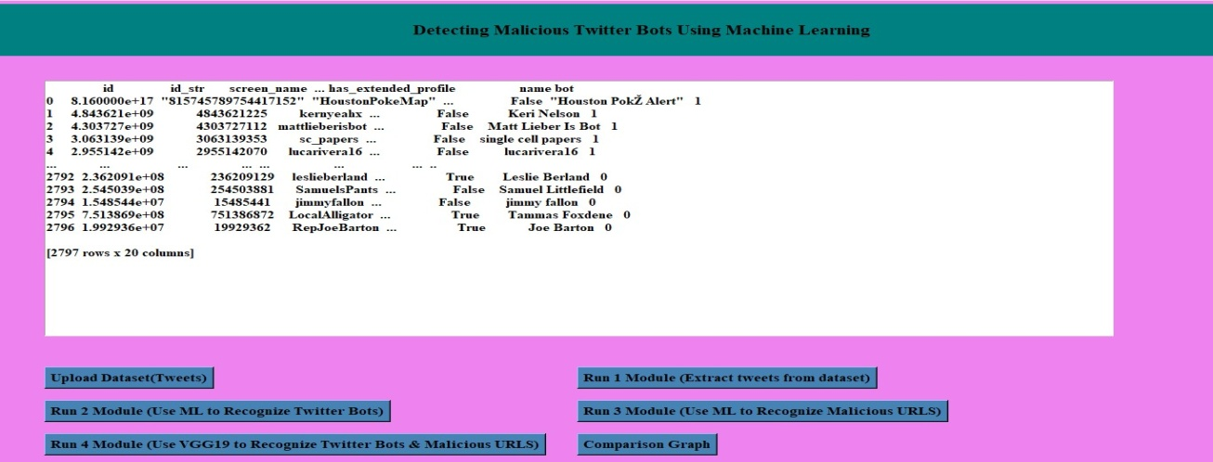
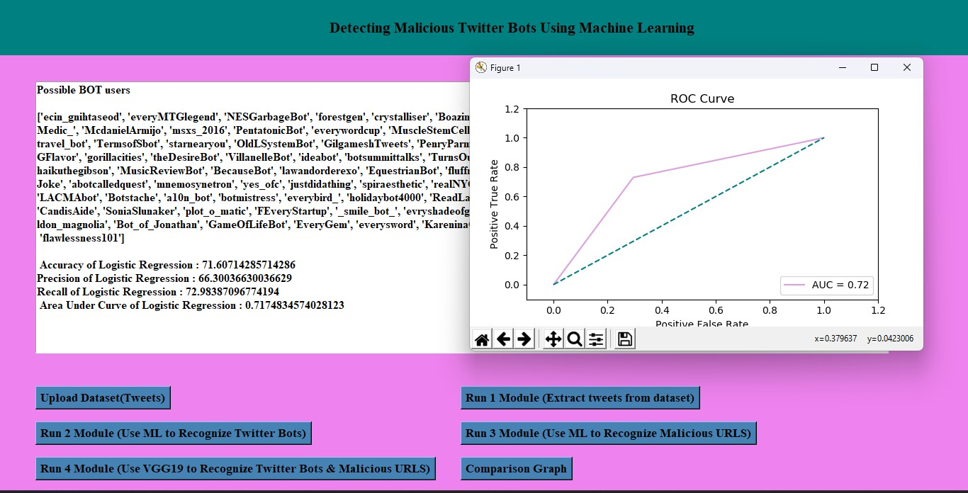
Result

Slide 22
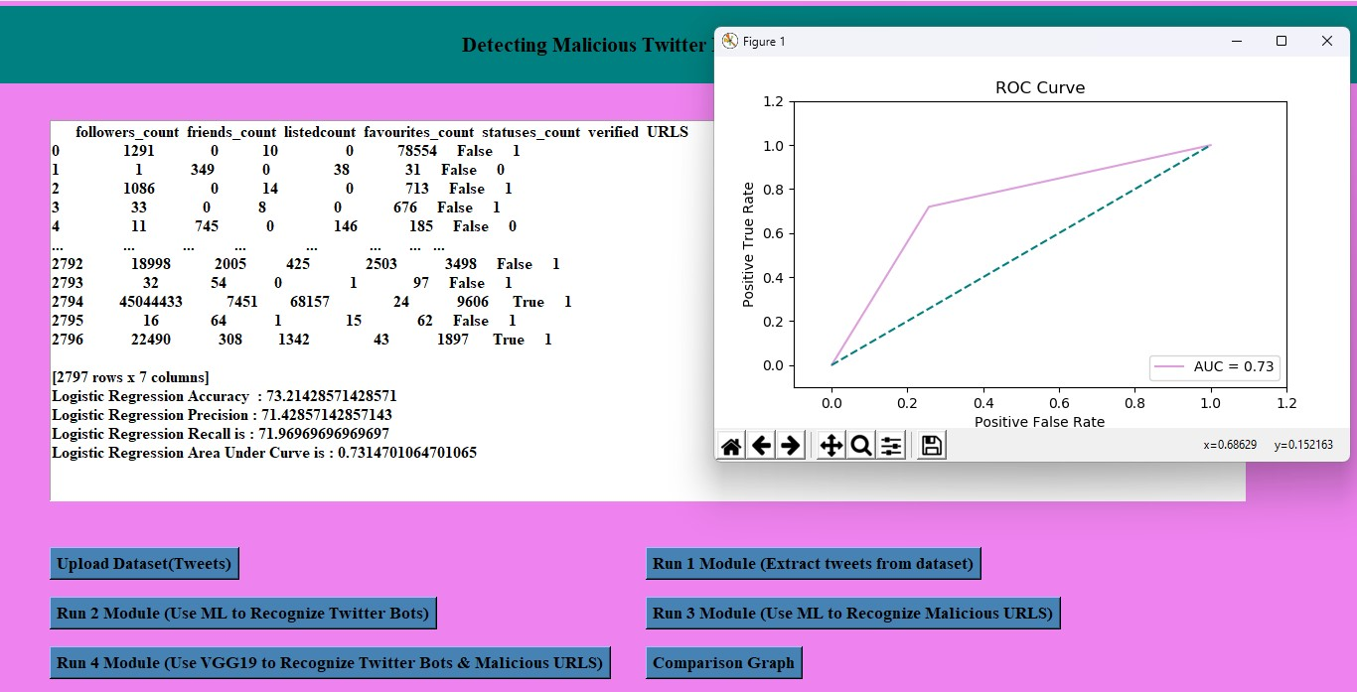
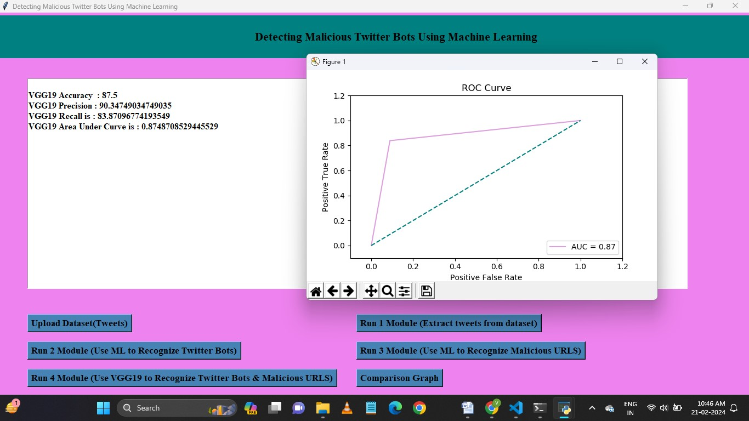

Slide 23
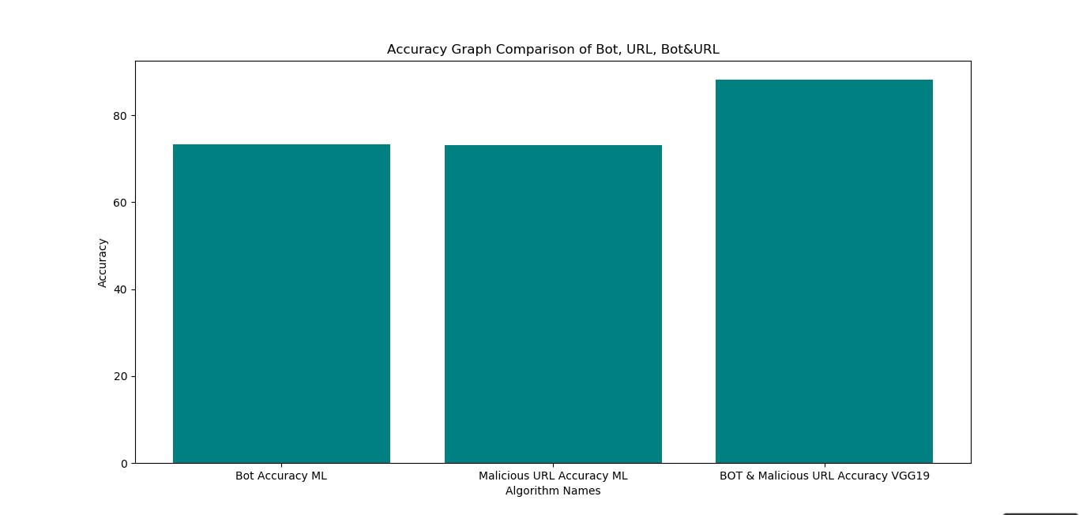

Slide 24
Conclusion
Developing a malicious Twitter bot detection system using machine learning is vital for preserving the integrity of online platforms. It addresses critical issues such as the spread of fake news, cyberbullying, and threats to digital democracy, making online spaces safer and more reliable.
We created a calculation in our investigate that distinguishes Twitter bots. Pack of words strategy for prepare information was the leading show VGG19 having tall precision compared to calculated relapse. Hence, word calculations were utilized to real-time information and the Twitter bots have been identified successfully. By using VGG19 along with convolutional neural network architecture we got a high accuracy when compared to Logistic regression machine learning algorithm.

Slide 25
Future Work
VGG19, a convolutional neural network architecture, for feature extraction from
Twitter bot images followed by Logistic Regression for classification can be a
best approach.
So, by using VGG19 architecture we can identify and classify any number of
images and any type of images and can detect malicious bots

Slide 26
References
Van Der Walt, Estée, and Jan Eloff. Using machine learning to detect fake identities: bots vs humans. IEEE Access 6 (2018): 6540-6549.
Sever Nasim, Mehwish, Andrew Nguyen, Nick Lothian, Robert Cope, and Lewis Mitchell. Real-time detection of content polluters in partially observable Twitter networks. arXiv preprint arXiv:1804.01235 (2018).
Khalil, Ashraf, Hassan Hajjdiab, and Nabeel Al-Qirim. Detecting Fake Followers in Twitter: A Machine Learning Approach. International Journal of Machine Learning and Computing 7, no.6(2017).
Wetstone, Jessica and Sahil R. Nayyar. I Spot a Bot: Building a binary classifier to detect bots on Twitter. (2017).
Karataş, Arzum, and SerapŞahin. A Review on Social Bot Detection Techniques and Research Directions. In Proc. Int. Security and Cryptology Conference Turkey, pp. 156-161. 2017.

Slide 27
Thank You!

